Slide 1
Python week 2
Canberra Chinese School Sem2

Slide 2
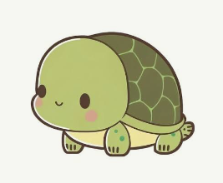

New Content: Turtle

Slide 3
Turtle
Since turtle needs to be installed locally to be used, most python websites don’t provide it.
So to use turtle, you can either use your local python IDE/interpreter, or use this special python website:
https://play.pyroom.app/playground

Slide 4
Turtle
To use Turtle, we must import it.
import turtle

Slide 5
Turtle
To use Turtle, we must import it.
Then, we bring the turtle out.
import turtle
t = turtle.Turtle()

Slide 6
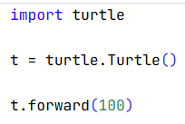
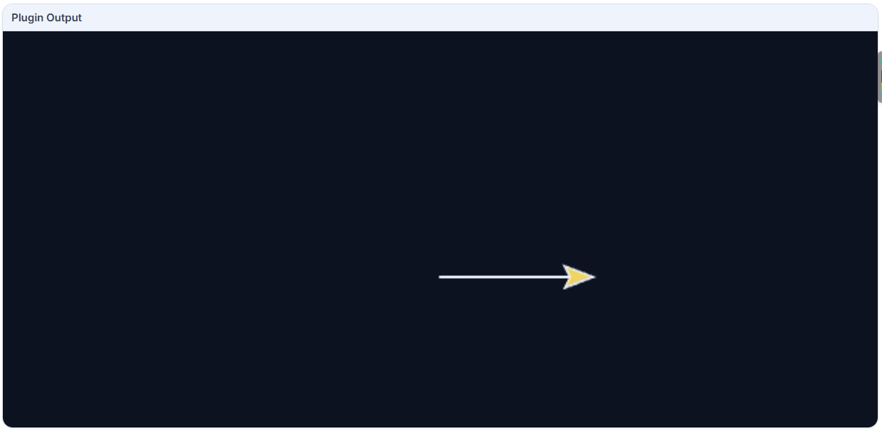
Turtle
Now let’s try to make it draw a line
But it looks pretty bad, so
Let’s customise our drawing window

Slide 7
Turtle
Let’s customise our drawing screen.
screen.bgcolor("lightblue")
This changes the background colour to light blue.
This also works with “green”, “lime”, “lightgreen”, “red”, etc

Slide 8
Turtle
Let’s give it a title.
screen.title("My Turtle Drawing")
Then let’s give our pen a shape.
t.shape("turtle")
You can replace turtle with arrow, classic, triangle, etc

Slide 9
Turtle
Let’s finally set a fixed pen speed, pen size and pen color.
t.speed(10)
t.pensize(1)
t.pencolor("black")

Slide 10
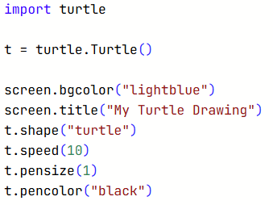
Turtle
The final setup (preparation) looks like this:

Slide 11
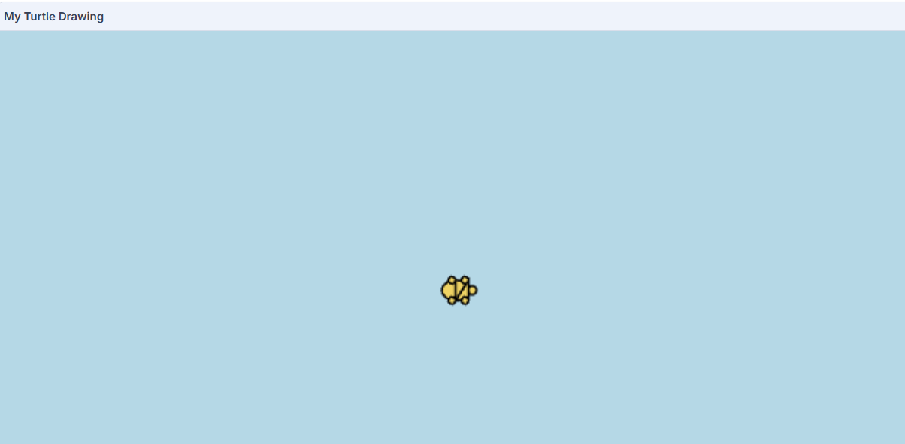
Turtle
But right now our turtle doesn’t do anything.

Slide 12
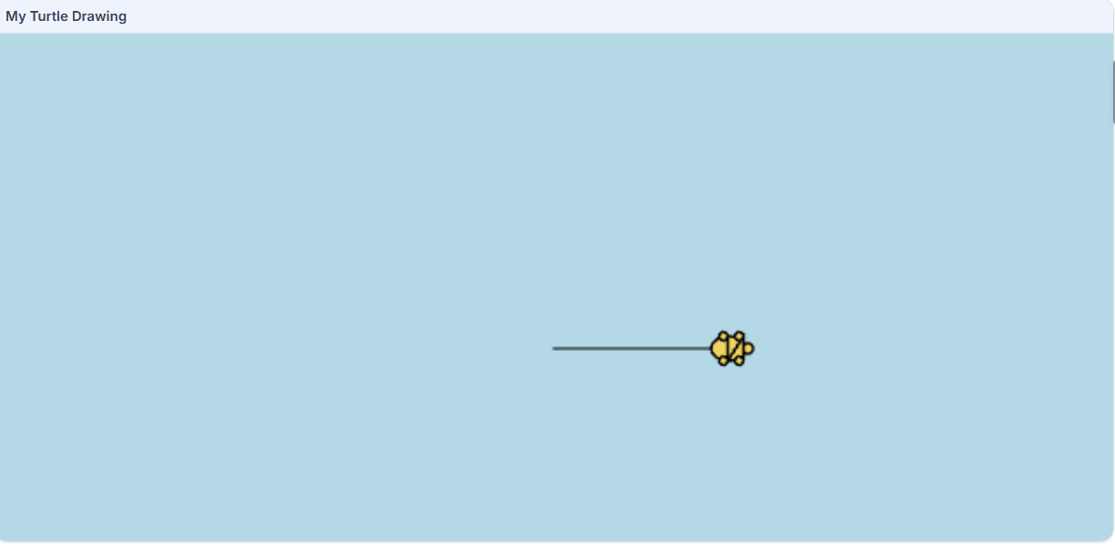
Turtle
Let’s make it draw a line.
t.forward(100) # the forward function makes the turtle move for some steps in the direction it is facing

Slide 13
Turtle
But what if we want it to make a turn?
t.left(90) makes the turtle make a 90° left turn
t.right(90) makes the turtle make a 90 ° right turn

Slide 14

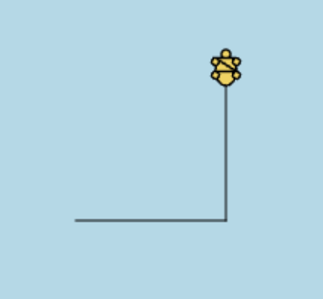
Turtle
Now let’s try this:

Slide 15
Turtle
Exercise:
How do we make a square?

Slide 16
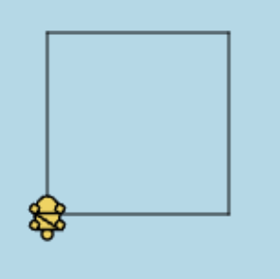
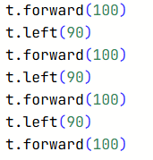
Turtle
Exercise:
How do we make a square?

Slide 17
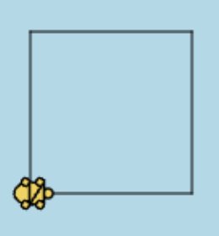

Turtle
Exercise:
How do we make a square?
We can shorten the code
a little bit

